Slide 1


Exploratory Data analysis (g2m Case study)
Virtual Internship – 3/18/2025

Slide 2
Background – G2m cab industry
XYZ is a private firm in US. Due to remarkable growth in the Cab Industry in last few years and multiple key players in the market, it is planning for an investment in Cab industry and as per their Go-to-Market(G2M) strategy they want to understand the market before taking final decision.
Project Delivery: The outcome of your delivery will be a presentation to XYZ’s Executive team. This presentation will be judged based on the visuals provided, the quality of your analysis and the value of your recommendations and insights.

Slide 3
Data information
Four data sets –Cab_Data.csv, Customer_ID.csv, Transaction_ID.csv, and City.csv
After combining into one master set :
-Total number of observations 359392
-Total number of files 4
-Total number of features 14
-Base format of the file .csv
-Size of the data 137.98 MB
*No missing values or duplicates

Slide 4
Cab_Data field names
Customer_ID Field names
Customer ID
Gender
Age
Income
Transaction ID
Date of Travel (Converted to ‘Date’ in my code)
Company
City
KM Travelled
Price Charged
Cost of Trip

Slide 5
Transaction_id field names
City_Data field names
Transaction ID
Customer ID
Payment_Mode
City
Population
Users

Slide 6
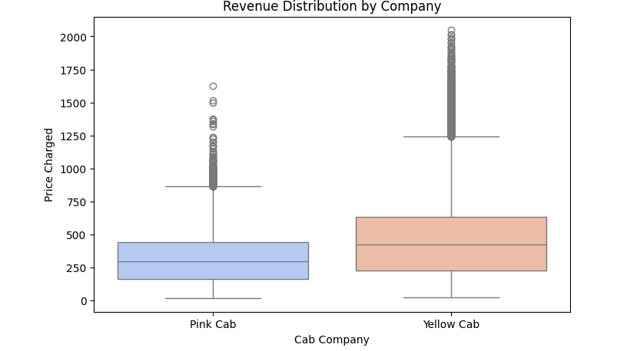
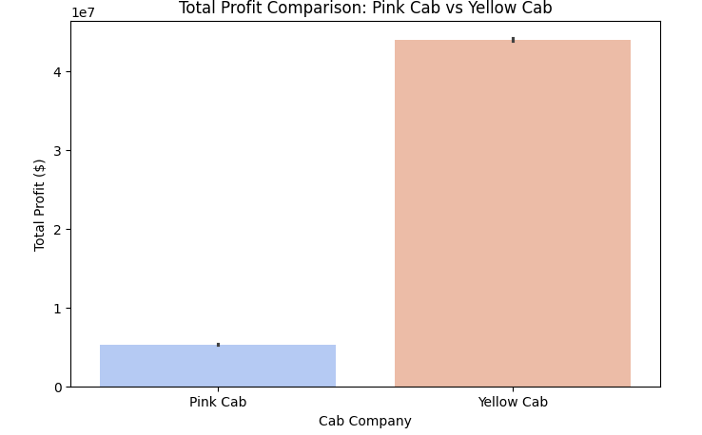
Profit analysis

Slide 7
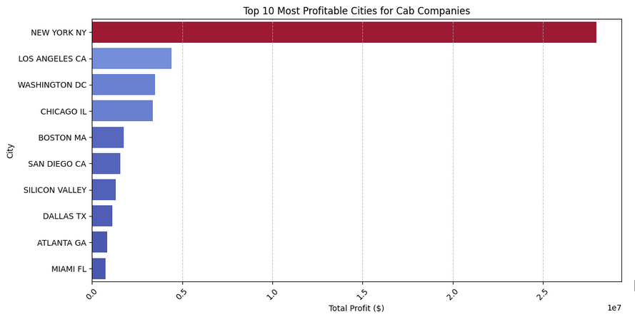
Top 10 profitable cities
New York dramatically stands out and exceeds all other cities
Smaller cities have significantly lower profit contribution

Slide 8
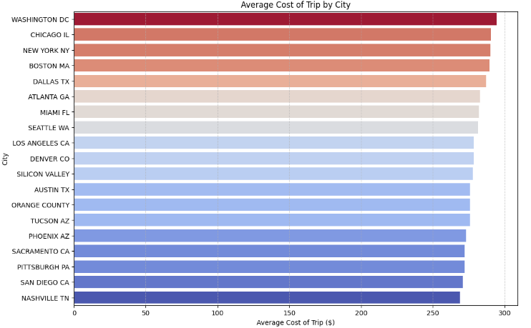
Average cost of trip by city

Slide 9
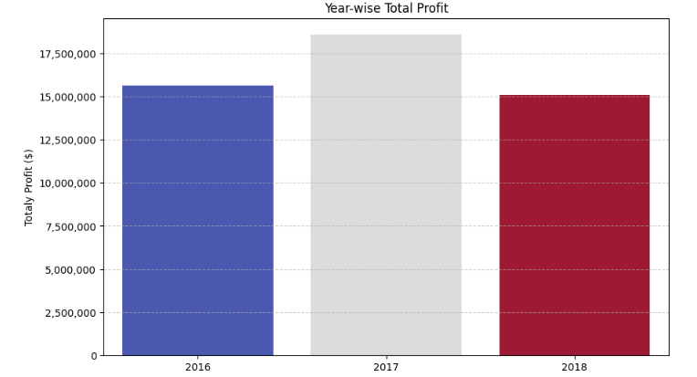
Year wise profit
2017 was the most profitable year
Slight fluctuations between 2016-2018 but stable profit
The decline in profit could indicate higher costs, economic changes, or increased competition

Slide 10
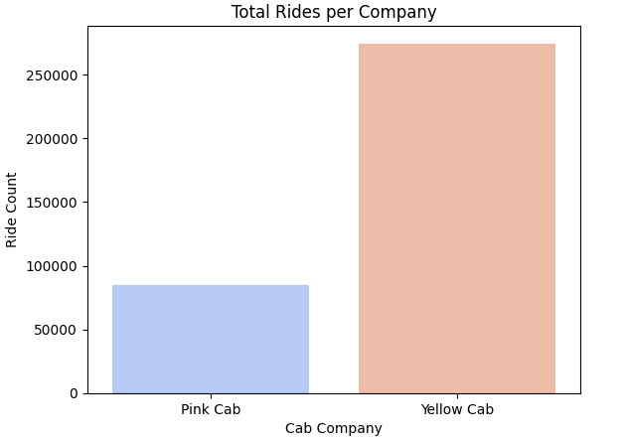
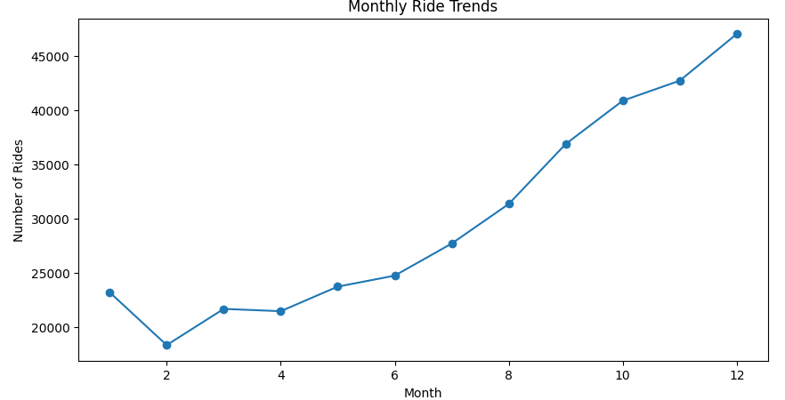
Ride trends

Slide 11
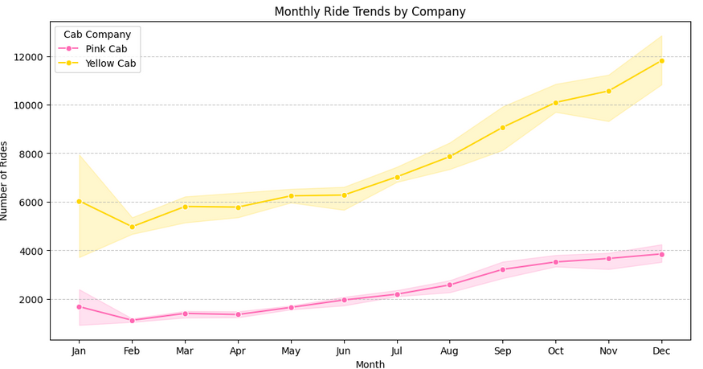
Monthly trend in depth
Both Yellow Cab and Pink Cab have a steady upward trend in ride volume
Yellow Cab exceeds Pink Cab in rides consistently
At the end of the year, Yellow Cab reaches close to 12,000 rides per month, while Pink Cab reaches around 4,000 rides per month, maintaining a 3:1 ratio.

Slide 12
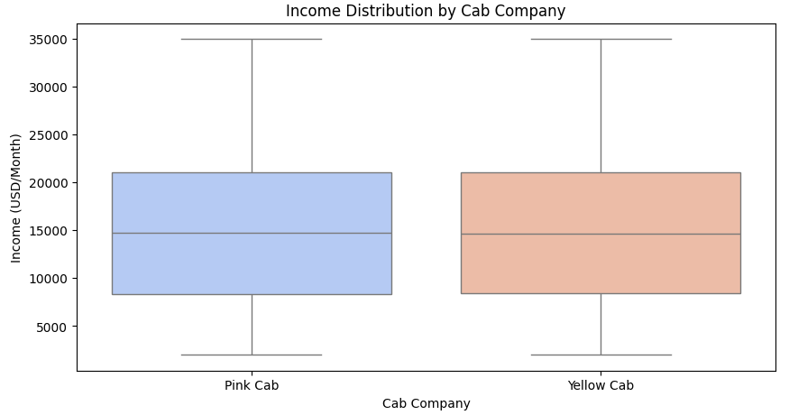
Income distribution

Slide 13
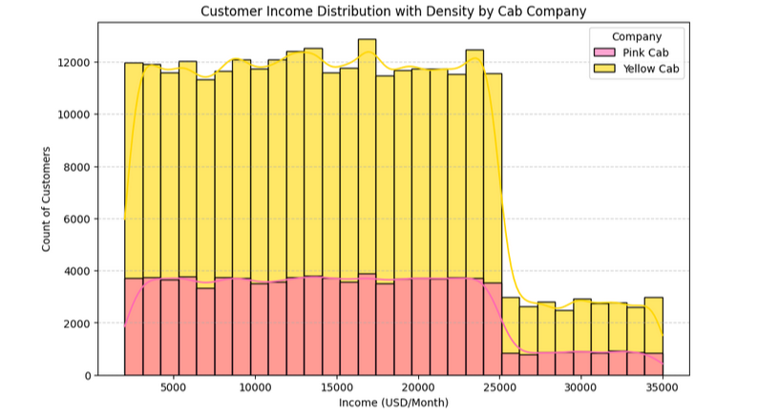
Customer income distribution
Yellow Cab mostly appeals to all income brackets
Pink Cab has similar appeals however; they bring in fewer customers
Core target consumers tend to be middle-income

Slide 14
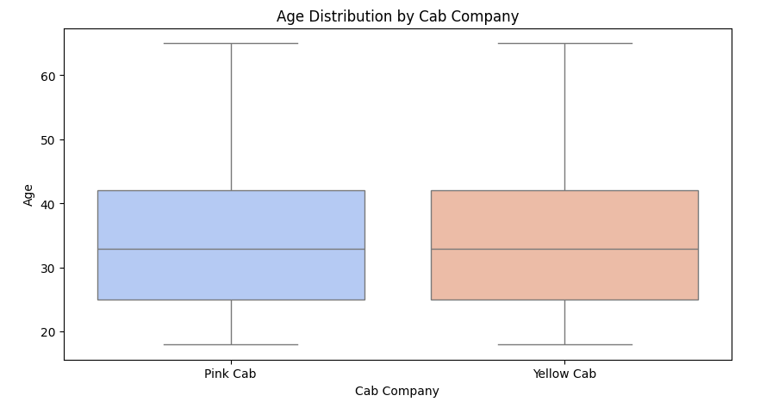
Age distribution

Slide 15
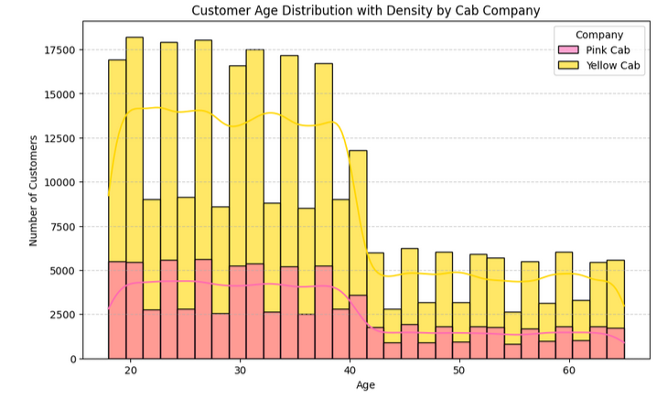
Customer age distribution
The number of customers are consistently higher in ages from 18-38 with a drop-off right around the age of 40
Customers past 40 are significantly lower but there

Slide 16
Recommendations from data analysis
Focus on high-profit cities: New York, Washington DC, Chicago, and Los Angeles are the top profit and high-cost cities. More advertising/marketing and loyalty programs can be applied within these cities.
Target young to middle-aged customers: This is the largest customer base and collaboration with universities, companies, and businesses could be profitable.
Prepare for Seasonal Changes: Ride volumes peak in Q4 of the year with a high holiday demand. Increase driver availability, number of cabs, run special promotions, and proactively plan ahead for the new year.
Pricing Optimization by City: Washington DC, New York, and Chicago have the highest trip costs. Premium pricing in these markets should remain consistent and be monitored for saturation or competitor pressure

Slide 17
Thank you!

